Slide 1

Take the Power of Stories and Gaming into Your Classroom
December 2021
John Heijligers, Martijn Klabbers
Challenge based learning

Slide 2
Overview
Introduction
Why focus on gamification and story telling
    The numbers
    Learning - what is it all about
    Escape Game
Training how to teach online
    Training
    7 principles
Over to you – workshop
    Feedback

Slide 3
Why storytelling and gamification?
The numbers

Slide 4
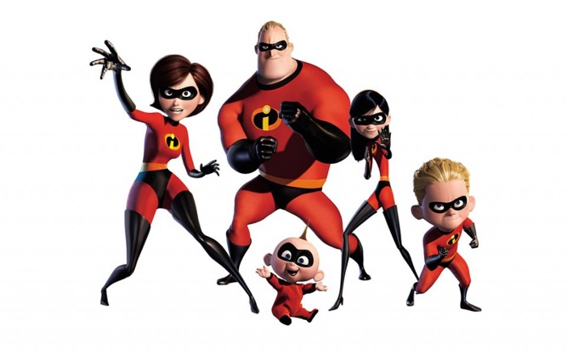
During corona
Sudden and total transformation to online learning
Basically, teachers were left to their devices and felt abandoned
And the pressure was already building up
We have to do this together – there is no help from outside
(incredible)

Slide 5
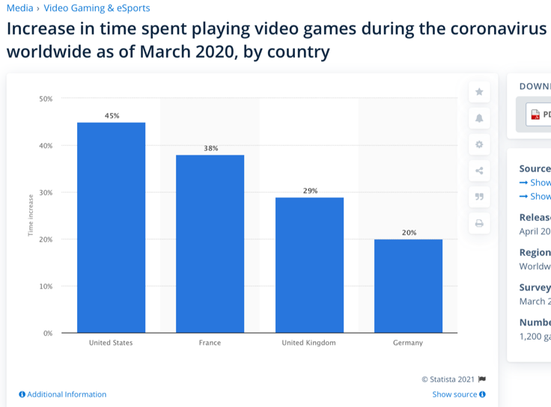
During corona
The power of
storytelling and gamification
Netflix had never had such an increase of subscribers as in the first quarter of 2020: 15,8 Mln

Slide 6



Learning – amazing achievements
Tools extend power and errors
And there is still a lot to discover
20 Nov’21: Nelson Dellis sets record at 2:22s for remembering a deck of cards

Slide 7
Why storytelling and gamification?
Learning what is it all about

Slide 8
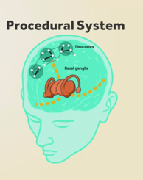
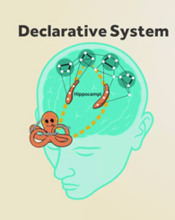
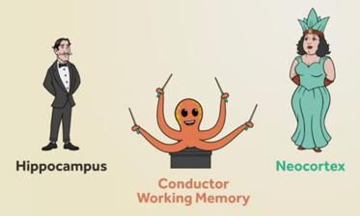
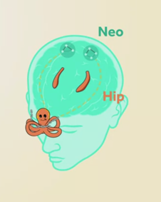
Learning - What do we know?
Locations, images, emotions (fun), smell, taste,
processing information, imagination, story lines
Engineering view – in a story
procedural, declaritive, focused & diffuse mode

Slide 9



Learning - What do we know?
Retrieval practice – getting things out
Spacing and interleaving
Metacognition
Prior knowledge can or cannot help
Organising knowledge influences learning
Motivation factors
Mastery learning by integrating
Importance of (timed) feedback
Learning in context of development and climate
Self-directed learning

Slide 10
Why storytelling and gamification?
Escape Game

Slide 11
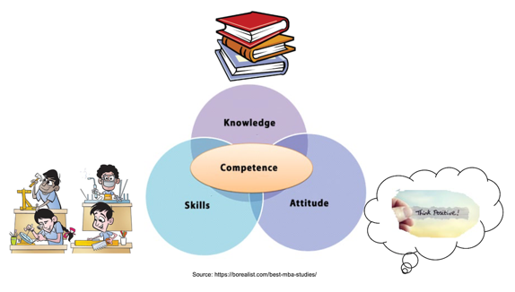
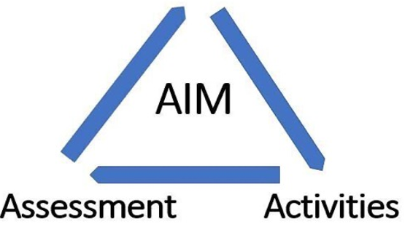
Escape game
Mimicking normal class in a game
Learning part – story line
Exam part – escape room
(Currently tested in a
VR setting at Coursera)
Competences

Slide 12
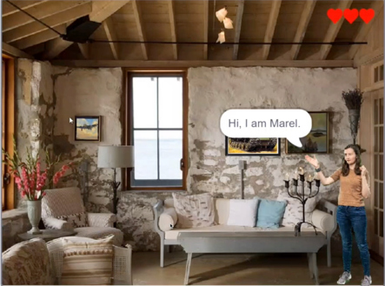
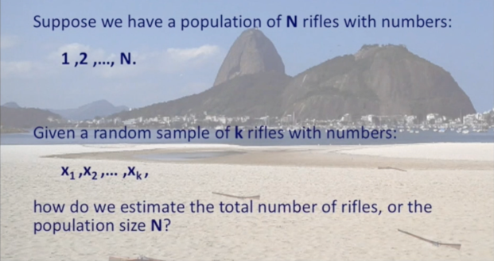
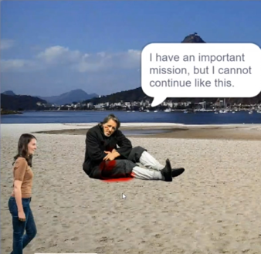
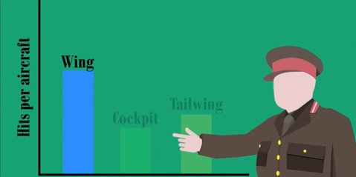

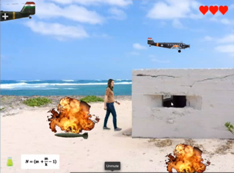
Story line of the escape game in statistics – learning part

Slide 13
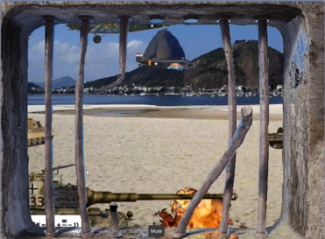
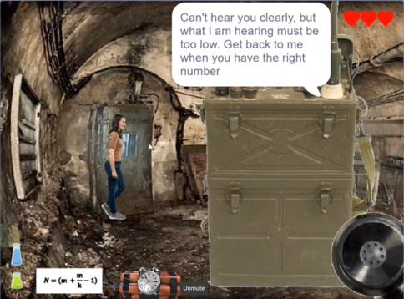

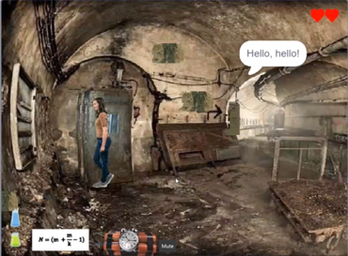
Story line of the escape game in statistics – Exam part

Slide 14
Prototype results

Slide 15
Training how to teach online
Training

Slide 16
Examples

Slide 17
Training how to teach online
7 principles

Slide 18
7 Principles
Plot
Character
Theme
Diction
Melody
Setting
Spectacle
Why/when
Who
What
Where
Result

Slide 19
Over to you

