Slide 1
ENGINEERING MASTER STUDIES BETWEEN TEACHING CHALLENGES AND SOCIETY 4.0 REALITIES
Prof. Mariana Mocanu, PhD
University Politehnica of Bucharest
OEB2021
Notes:
I am MM, profesor at the UPB, dept for CS and I am glad to share with you our experience regarding the challenges for the engineering master studies in the society 4.0 context.

Slide 2
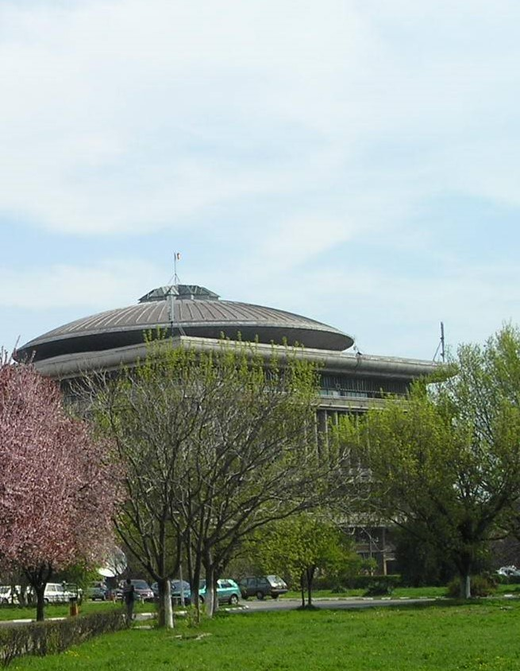
The University POLITEHNICA of Bucharest
Established in 1818 as the first HE engineering institution
over 25.000 students (bachelor, master, PhD)
15 engineering faculties
We offer education in several forms:
Face to face learning; Distance learning; CAI - Computer Aided Instruction; CBL – Computer Based Learning; WBL – Web-Based Learning; Blended Learning
We are part of EELISA - European Engineering Learning Innovation and Science Alliance
We participate in joint education programs
ERASMUS
Bilateral agreements
Notes:
With over 200 years of existence, UPB is the most representative technical university in Romaniain Romania.
Over 25000 students attend the study programmes offered by 15 faculties on bachelor, master and PhD level.
Teaching is done mainly mainly in traditional f2f form, but we implement also different forms of online education.
We also participate in joint education programs (under ERASMUS or Bilateral agreements)

Slide 3
Industry 4.0
Industry 4.0 is the digital transformation of manufacturing/production and related industries and value creation processes
Optimize Operations and Shape Future Innovation
Interconnected environment of people and infrastructure
Post-digital reality requires:
  Openness
  Collaboration
  Sharing

Slide 4
Engineering master studies
UPB offers 174 master’s study programs – 33 in foreign languages
Prepare highly skilled master graduates for Industry 4.0 labor market
  in the specific area of activity
  in using tools and methods based on advanced technologies
  In communicating (people and machines)
Offer better opportunities to access good jobs
  wider spectrum of jobs
  better paid jobs

Slide 5
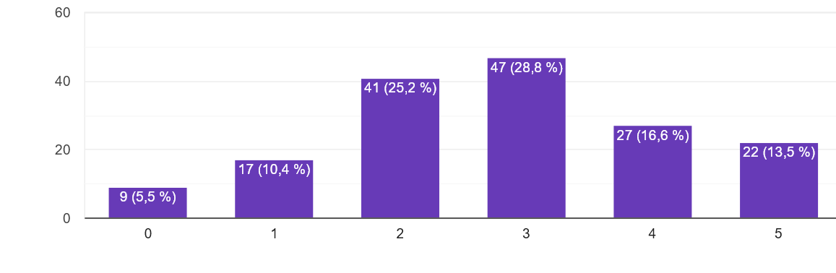
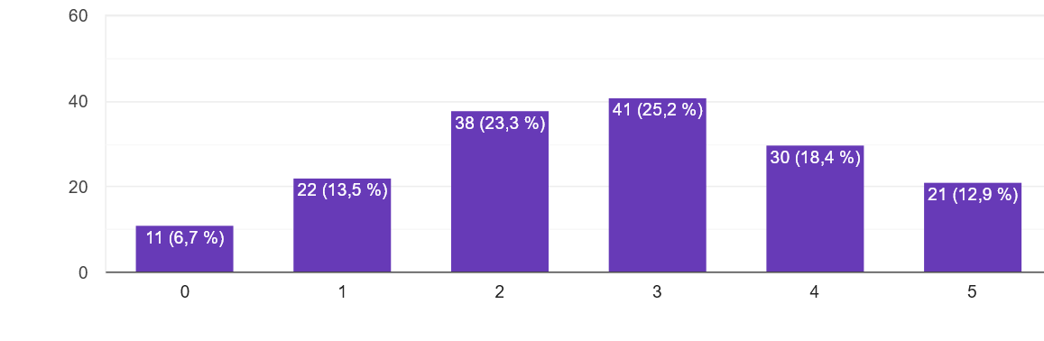
We asked the students:
To what extent do you consider that the learning outcomes (competencies, abilities) acquired by following the master's program are useful in your work?
To what extent do you consider that the master's degree contributes to career advancement?
(0 = not at all; 5 = very much)

Slide 6
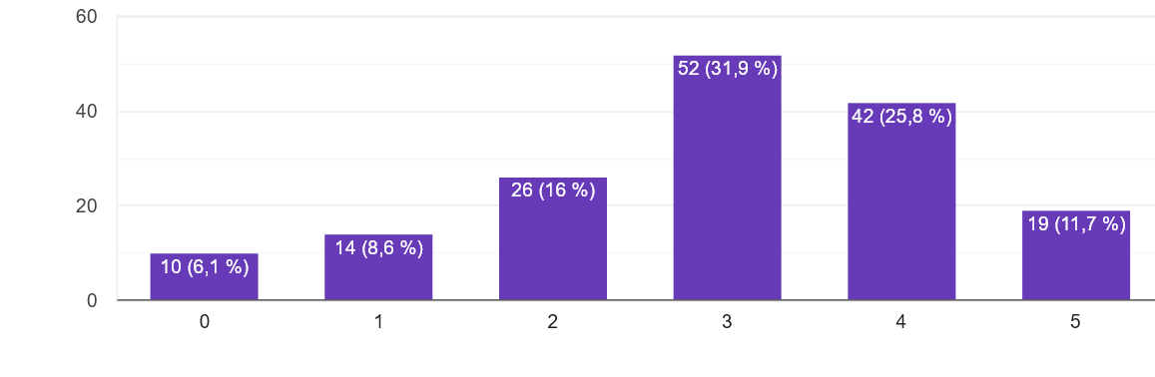
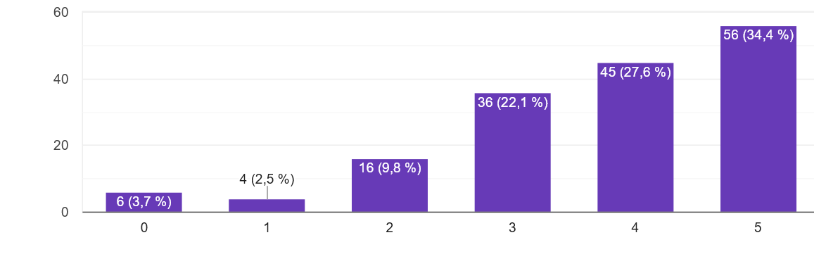
We asked the students:
To what extent do you consider a master's program focused on mastering advanced technologies to be useful?
To what extent do you consider an interdisciplinary master's program useful to you?
(0 = not at all; 5 = very much)

Slide 7
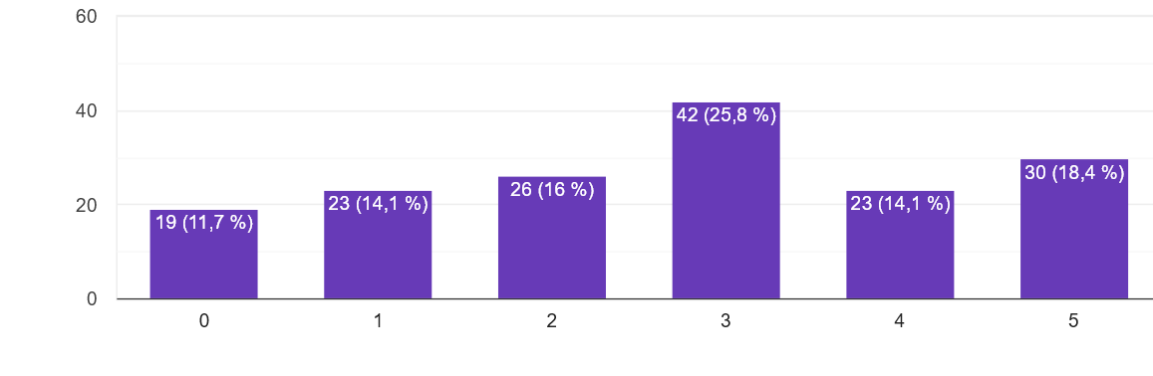
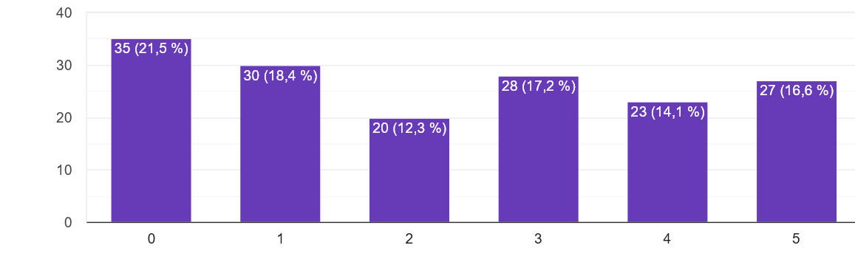
We asked the students:
To what extent are you encouraged by your employer to pursue a master's program at the same time as taking a job?
To what extent being employed helps you go through the master’s program?
(0 = not at all; 5 = very much)

Slide 8
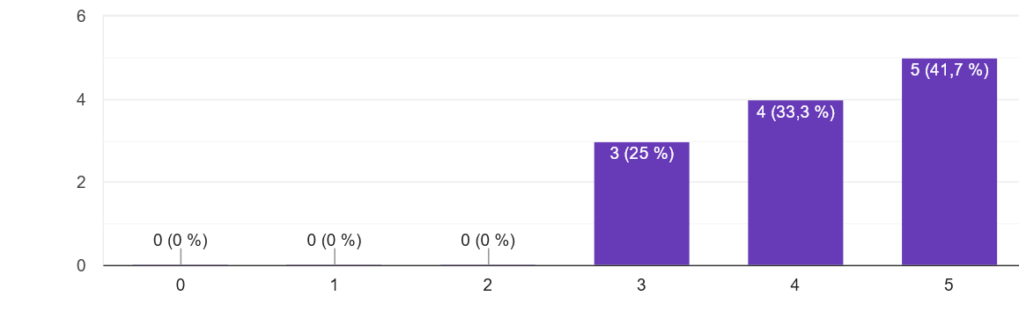
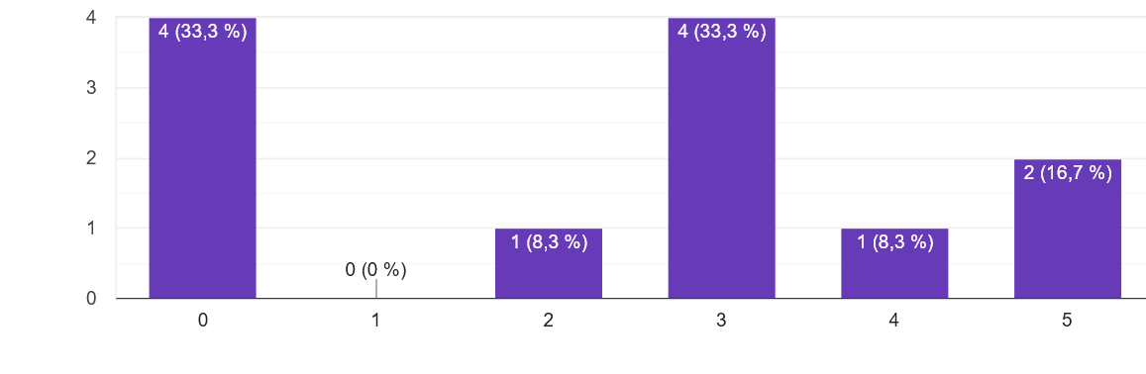
We asked the employers:
To what extent do you take into account the level of education of the candidates when hiring?
To what extent are you willing to sponsor a master's program that prepares master's students in your field of activity?
(0 = not at all; 5 = very much)

Slide 9
We asked employers:
What do you appreciate about your employees who are going through or have graduated a master's program?

Slide 10
We asked the students:
On the market there is a rich offer of short-term training courses, on narrow topics. What do you think is more useful?

Slide 11
We asked the students:
If you had to choose between pursuing a master's program and a job, what would you decide?

Slide 12
Does a higher qualification offer more job opportunities?
Profile of jobs;
Technological evolution;
Increased diversity of solutions;
A narrow specialization lowers the job availability
no. of possible occupations
1 2 3 4 5 6 7 8
EQF Levels
Notes:
Most of the jobs in engineering require bachelor level of competences;
The rapid technological evolution cannot be followed by equally rapid update of study programs;
The diversity of existing work environment, tools, methods in a specific field cannot be covered by a study program;

Slide 13
Labor market and education regulations
ISCO -08 |  | ISCED 97 | ISCED 2011 | EQF Levels
Skill levels | Education requirements
4 - performance of tasks that require complex problem-solving, decision-making and creativity based on an extensive body of theoretical and | Level 5a or higher; Experience; Training on-the-job | 6 second stage of tertiary education | 8 Doctorate | 8 Doctorate
 |  | 5a first stage of tertiary education | 7 Master | 7 Master
 |  |  | 6 Bachelor | 6 Bachelor
3 - performance of complex technical and practical tasks that require an extensive body of factual, technical and procedural knowledge in a specialized field. | Level 5b; Experience; Training on-the-job | 5b first stage of tertiary education | 5 Short cycle | 5
 |  | 4 post secondary non-tertiary education | 4 | 4
2 - performance of tasks such as operating machinery and electronic equipment; driving vehicles; maintenance and repair | Level 4 / 3 / 2; Experience; Training on-the-job | 3 upper secondary education | 3 | 3
 |  | 2 lower secondary education | 2 | 2
1 - performance of simple and routine physical or manual tasks | Level 1; Training on-the-job | 1 1rimary education | 1 | 1

Slide 14
Conclusions
Closer collaboration with the labor market is needed
Greater flexibility is needed in organizing master's studies
  Accreditation, periodic evaluation and management of master's programs is cumbersome and does not allow a rapid response to market requirements.
Modular programs, based on microcredit developed in collaboration with economic agents, can be a solution for the future.
  The question is how to equate a microcredit amount with a master's program that has clear objectives and a sound curriculum.

Slide 15
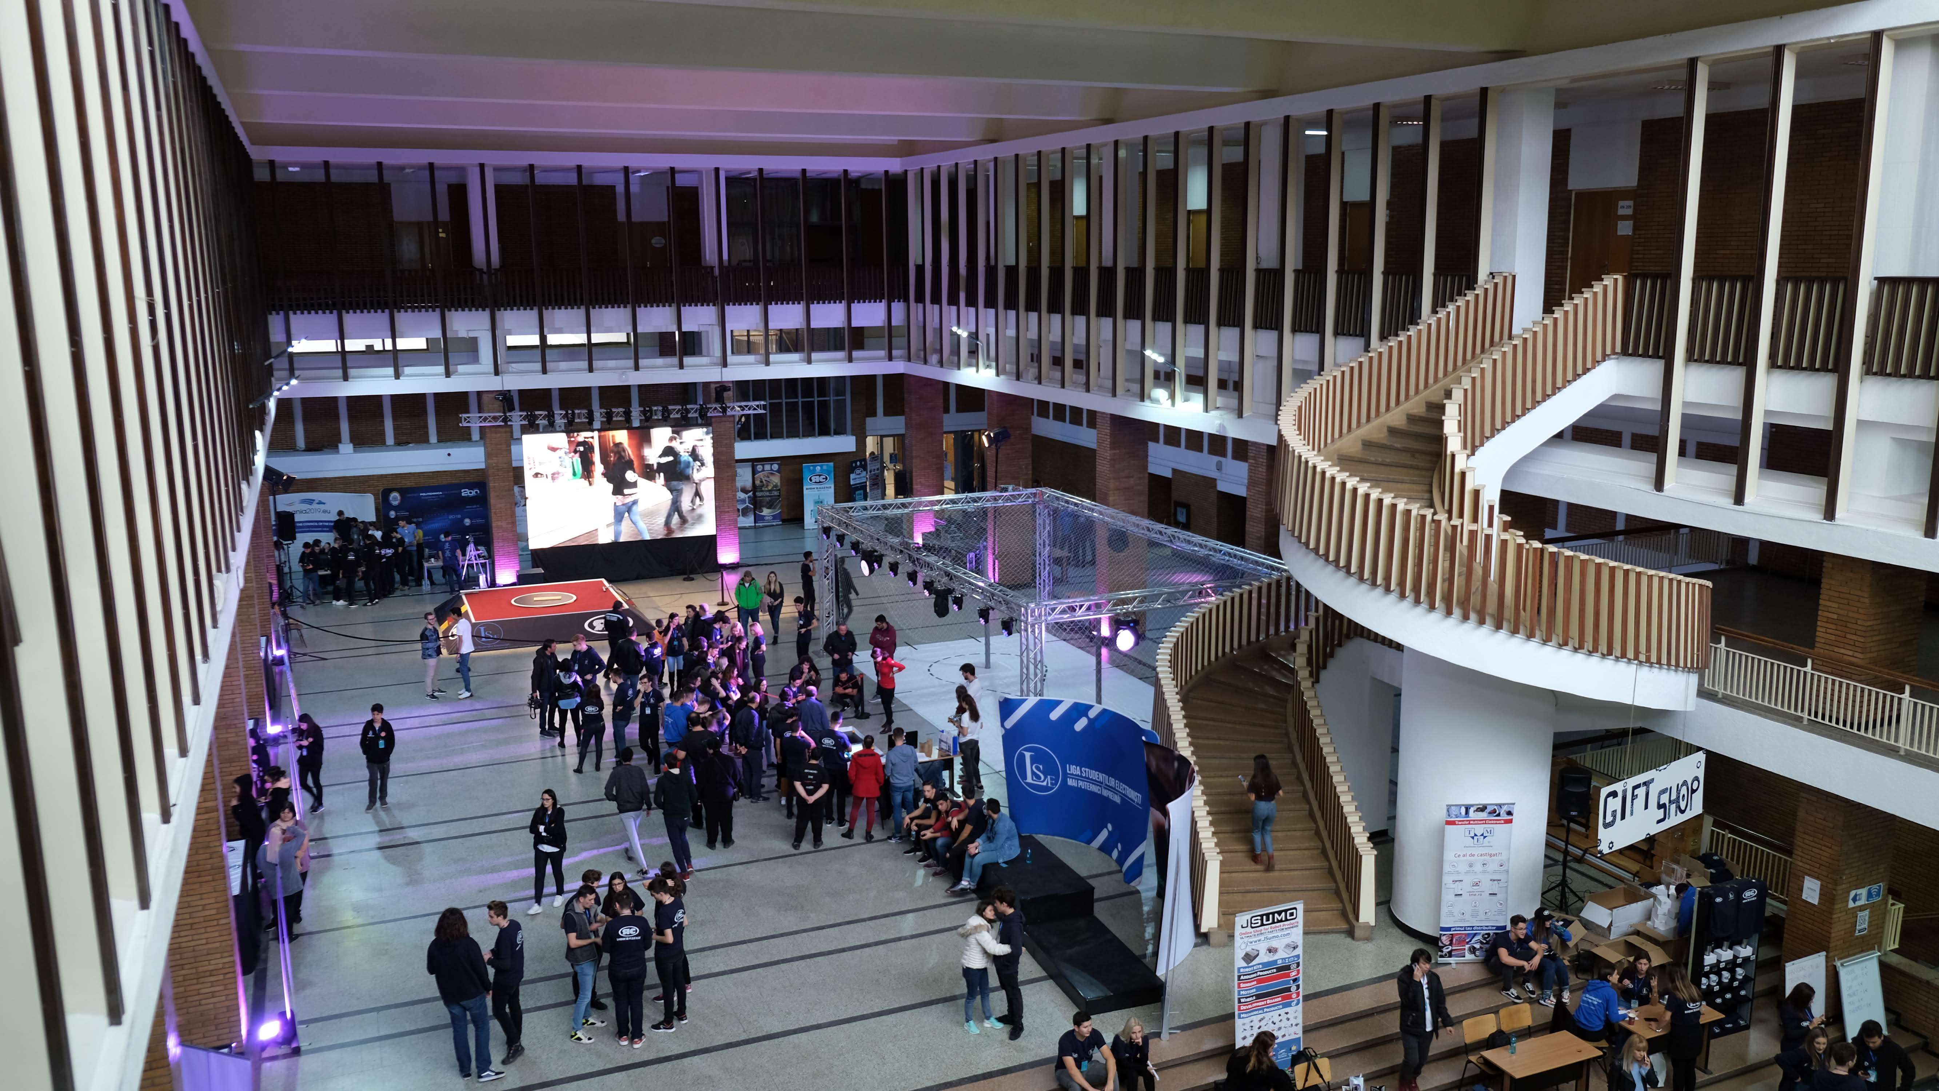
Thank you for your attention!
See you soon in Bucharest!

